Slide 1

About the Presentations
The presentations cover the objectives found in the opening of each chapter.
All chapter objectives are listed in the beginning of each presentation.
You may customize the presentations to fit your class needs.
Some figures from the chapters are included. A complete set of images from the book can be found on the Instructor Resources disc.
©2016. Cengage Learning. All rights reserved.

Slide 2
Oracle 12c: SQL
Chapter 9
Joining Data from Multiple Tables
©2016. Cengage Learning. All rights reserved.

Slide 3
Objectives
Identify a Cartesian join
Create an equality join using the WHERE clause
Create an equality join using the JOIN keyword
Create a non-equality join using the WHERE clause
Create a non-equality join using the JOIN…ON approach
©2016. Cengage Learning. All rights reserved.

Slide 4
Objectives (continued)
Create a self-join using the WHERE clause
Create a self-join using the JOIN keyword
Distinguish an inner join from an outer join
Create an outer join using the WHERE clause
Create an outer join using the OUTER keyword
Use set operators to combine the results of multiple queries
©2016. Cengage Learning. All rights reserved.

Slide 5
Purpose of Joins
Joins are used to link tables and reconstruct data in a relational database
Joins can be created through:
  Conditions in a WHERE clause
  Use of JOIN keywords in FROM clause
©2016. Cengage Learning. All rights reserved.

Slide 6
Cartesian Joins
Created by omitting joining condition in the WHERE clause or through CROSS JOIN keywords in the FROM clause
Results in every possible row combination (m * n)
©2016. Cengage Learning. All rights reserved.

Slide 7
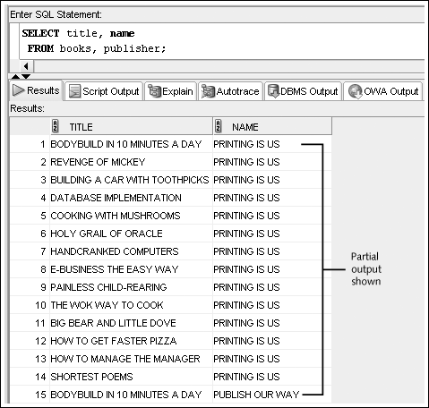
Cartesian Join Example:
Omitted Condition
©2016. Cengage Learning. All rights reserved.

Slide 8
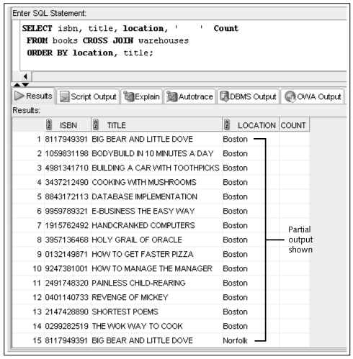
Cartesian Join Example:
CROSS JOIN Keywords
©2016. Cengage Learning. All rights reserved.

Slide 9
Equality Joins
Link rows through equivalent data that exists in both tables
Created by:
  Creating equivalency condition in the WHERE clause
  Using NATURAL JOIN, JOIN…USING, or JOIN…ON keywords in the FROM clause
©2016. Cengage Learning. All rights reserved.

Slide 10
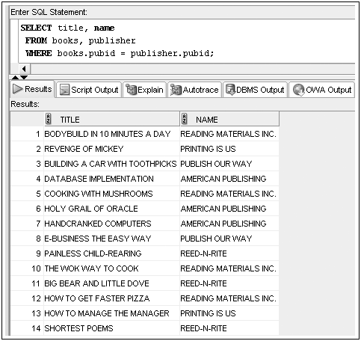
Equality Joins: WHERE Clause Example
©2016. Cengage Learning. All rights reserved.

Slide 11
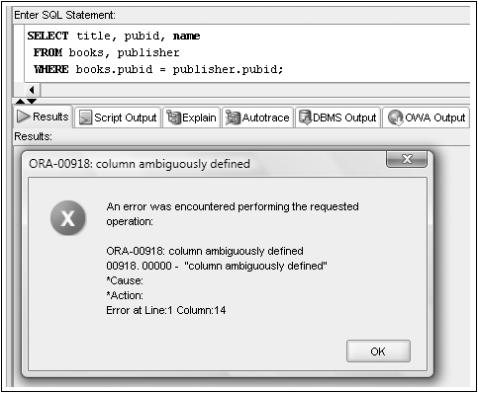
Qualifying Column Names
Columns in both tables must be qualified
©2016. Cengage Learning. All rights reserved.

Slide 12
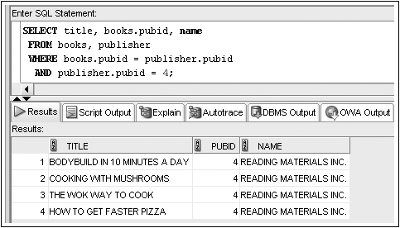
WHERE Clause Supports Join and Other Conditions
©2016. Cengage Learning. All rights reserved.

Slide 13
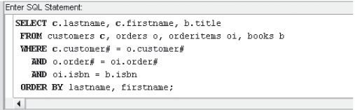
Joining More Than Two Tables
Joining four tables requires three join conditions
©2016. Cengage Learning. All rights reserved.

Slide 14

Equality Joins: NATURAL JOIN
©2016. Cengage Learning. All rights reserved.

Slide 15
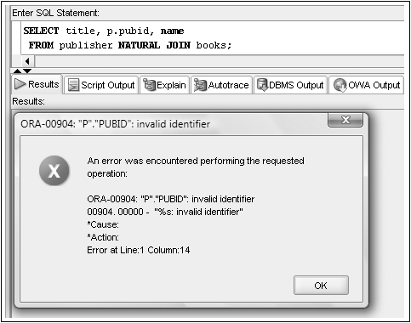
No Qualifiers with a NATURAL JOIN
©2016. Cengage Learning. All rights reserved.

Slide 16

Equality Joins: JOIN…USING
©2016. Cengage Learning. All rights reserved.

Slide 17

Equality Joins: JOIN…ON
Required if column names are different
©2016. Cengage Learning. All rights reserved.

Slide 18
JOIN Keyword Overview
Use JOIN…USING when tables have one or more columns in common
Use JOIN…ON when same named columns are not involved or a condition is needed to specify a relationship other than equivalency (next section)
Using the JOIN keyword frees the WHERE clause for exclusive use in restricting rows
©2016. Cengage Learning. All rights reserved.

Slide 19
Non-Equality Joins
In WHERE clause, use any comparison operator other than the equal sign
In FROM clause, use JOIN…ON keywords with a non-equivalent condition
©2016. Cengage Learning. All rights reserved.

Slide 20

Non-Equality Joins: WHERE Clause Example
©2016. Cengage Learning. All rights reserved.

Slide 21

Non-Equality Joins: JOIN…ON Example
©2016. Cengage Learning. All rights reserved.

Slide 22
Self-Joins
Used to link a table to itself
Requires the use of table aliases
Requires the use of a column qualifier
©2016. Cengage Learning. All rights reserved.

Slide 23
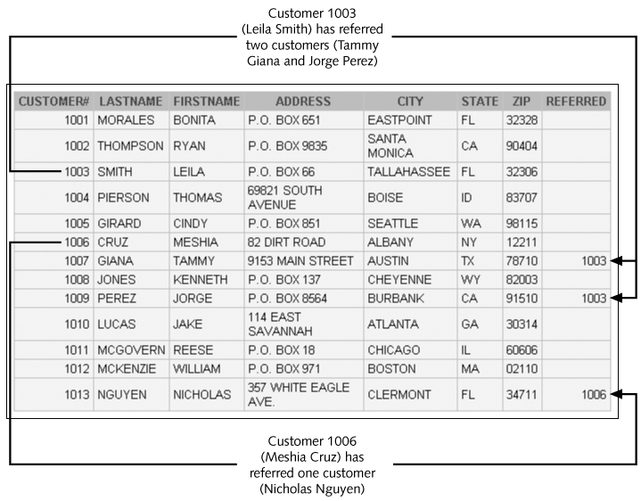
Customer Table Example
©2016. Cengage Learning. All rights reserved.

Slide 24
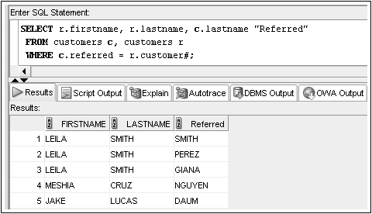
Self-Joins: WHERE Clause Example
©2016. Cengage Learning. All rights reserved.

Slide 25
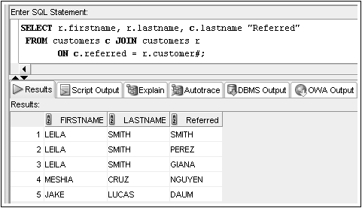
Self-Joins: JOIN…ON Example
©2016. Cengage Learning. All rights reserved.

Slide 26
Outer Joins
Use outer joins to include rows that do not have a match in the other table
In WHERE clause, include outer join operator (+) immediately after the column name of the table with missing rows to add NULL rows
In FROM clause, use FULL, LEFT, or RIGHT with OUTER JOIN keywords
©2016. Cengage Learning. All rights reserved.

Slide 27
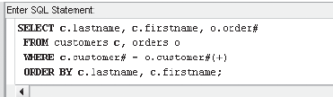
Outer Joins: WHERE Clause Example
©2016. Cengage Learning. All rights reserved.

Slide 28
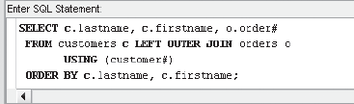
Outer Joins: OUTER JOIN Keyword Example
©2016. Cengage Learning. All rights reserved.

Slide 29
Outer Joins (continued)
If multiple join conditions are used, the outer join condition may be required in all of the join conditions to retain nonmatching rows
©2016. Cengage Learning. All rights reserved.

Slide 30
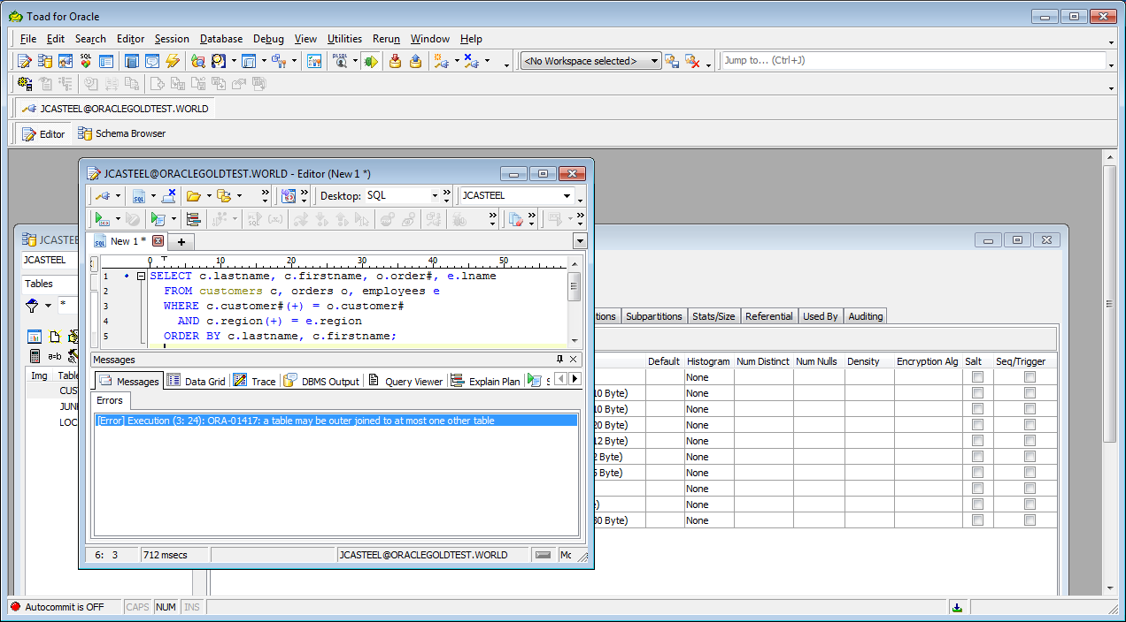
Outer Joins (continued)
In previous versions of Oracle an error would be raised if the outer join operator is used on the same table in more than one join operation
©2016. Cengage Learning. All rights reserved.

Slide 31
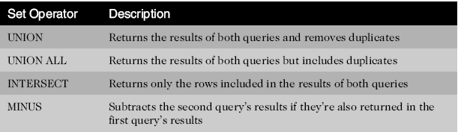
Set Operators
Used to combine the results of two or more SELECT statements
©2016. Cengage Learning. All rights reserved.

Slide 32
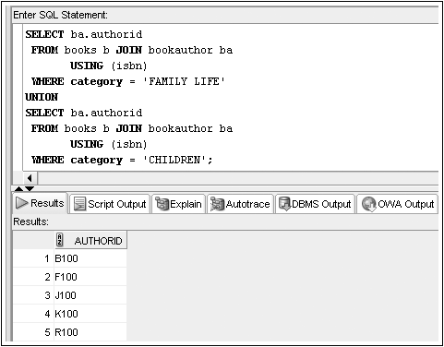
Set Operators: UNION Example
©2016. Cengage Learning. All rights reserved.

Slide 33
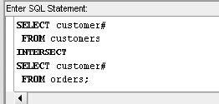
Set Operators: INTERSECT Example
©2016. Cengage Learning. All rights reserved.

Slide 34
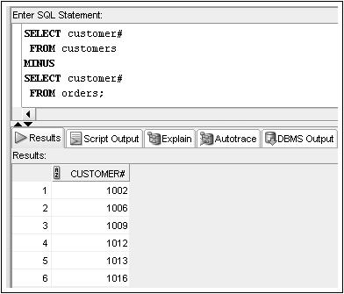
Set Operators: MINUS Example
©2016. Cengage Learning. All rights reserved.

Slide 35
Summary
Data stored in multiple tables regarding a single entity can be linked together through the use of joins
A Cartesian join between two tables returns every possible combination of rows from the tables; the resulting number of rows is always m * n
An equality join is created when the data joining the records from two different tables are an exact match
A non-equality join establishes a relationship based upon anything other than an equal condition
Self-joins are used when a table must be joined to itself to retrieve needed data
©2016. Cengage Learning. All rights reserved.

Slide 36
Summary (continued)
Inner joins are categorized as being equality, non-equality, or self-joins
An outer join is created when records need to be included in the results without having corresponding records in the join tables
  The record is matched with a NULL record so it will be included in the output
Set operators such as UNION, UNION ALL, INTERSECT, and MINUS can be used to combine the results of multiple queries
©2016. Cengage Learning. All rights reserved.

